Slide 1
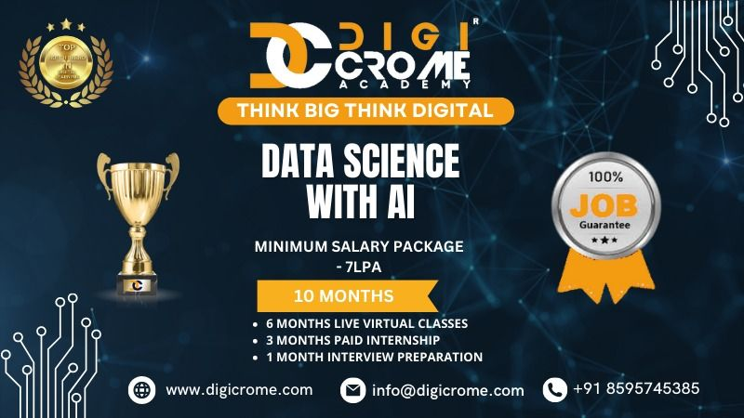
DIGICROME ACADEMY
NEXT HIKES
2023-24

Slide 2
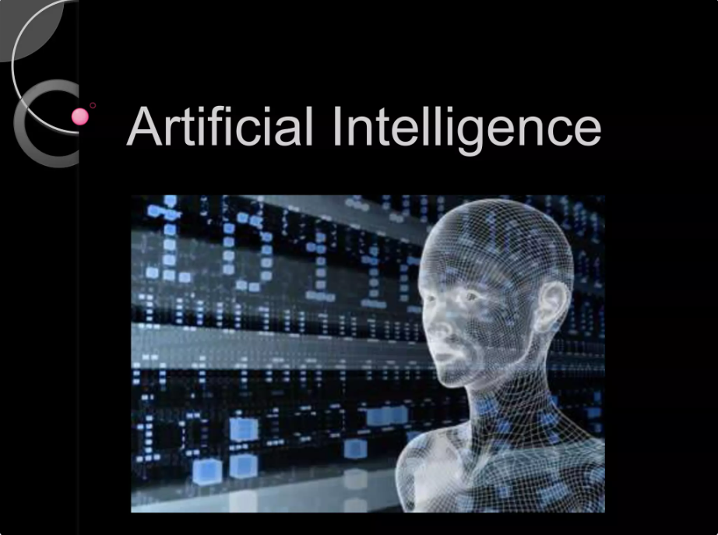
What do you think Artificial Intelligence is?
Career Trends Explorer and Personalized Job Matcher

Slide 3
PROBLEM STATEMENT
THE PROJECT SEEKS TO OFFER VALUABLE INSIGHTS INTO WORKFORCE TRENDS WHILE DEVELOPING A PERSONALIZED JOB RECOMMENDATION SYSTEM. BY ANALYZING JOB MARKET DATA, THE PLATFORM WILL IDENTIFY IN-DEMAND ROLES, REVEAL SALARY TRENDS, SPOTLIGHT EMERGING JOB CATEGORIES, AND PROVIDE JOB SEEKERS WITH CUSTOMIZED OPPORTUNITIES THAT MATCH THEIR PREFERENCES AND INDUSTRY DEMANDS.
SITUATIONAL OVERVIEW
THE JOB MARKET IS DYNAMIC, INFLUENCED BY TECHNOLOGICAL DISRUPTIONS, ECONOMIC CYCLES, AND EVOLVING WORK PREFERENCES SUCH AS REMOTE JOBS. THIS PROJECT WILL LEVERAGE ADVANCED DATA ANALYTICS AND PREDICTIVE MODELING TO UNCOVER VALUABLE INSIGHTS, EMPOWERING BOTH JOB SEEKERS AND RECRUITERS TO MAKE INFORMED, STRATEGIC DECISIONS. BY COMBINING HISTORICAL AND LIVE JOB POSTING DATA, THE PLATFORM WILL ACT AS A ONE-STOP TOOL FOR CAREER TRENDS EXPLORATION AND PERSONALIZED JOB RECOMMENDATIONS.

Slide 4
EXPLORATORY DATA ANALYSIS (EDA)
CONTENTS
STEPS IN EXPLORATORY DATA ANALYSIS (EDA)
SOFTWARE REQUIREMENTS
FLOW CHART OF EXPLORATORY DATA ANALYSIS .

Slide 5
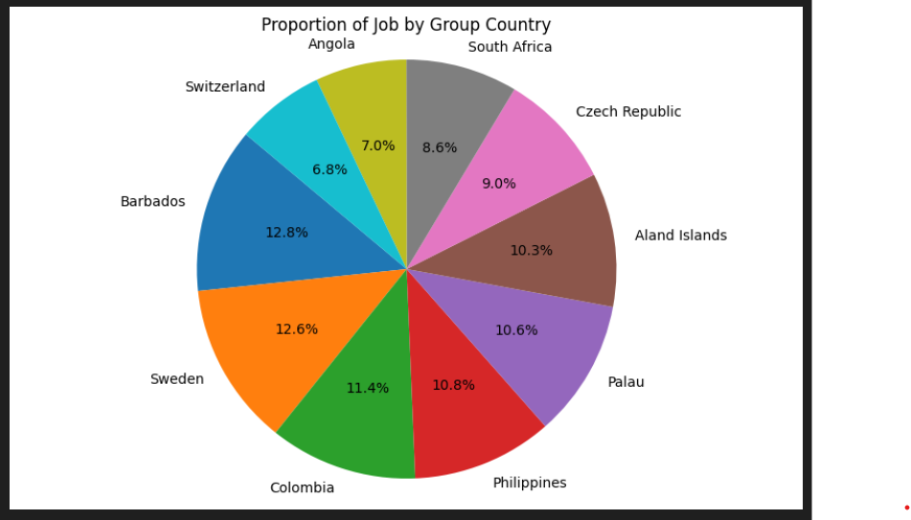
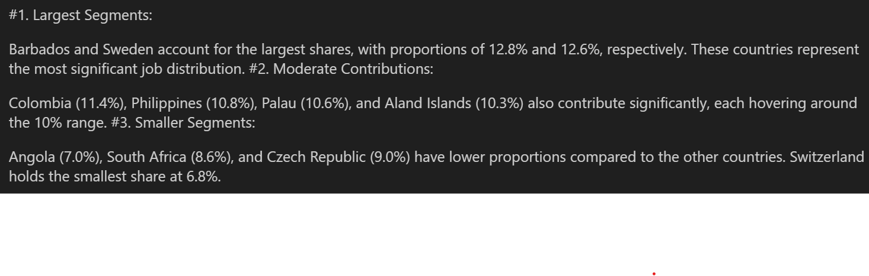

Slide 6
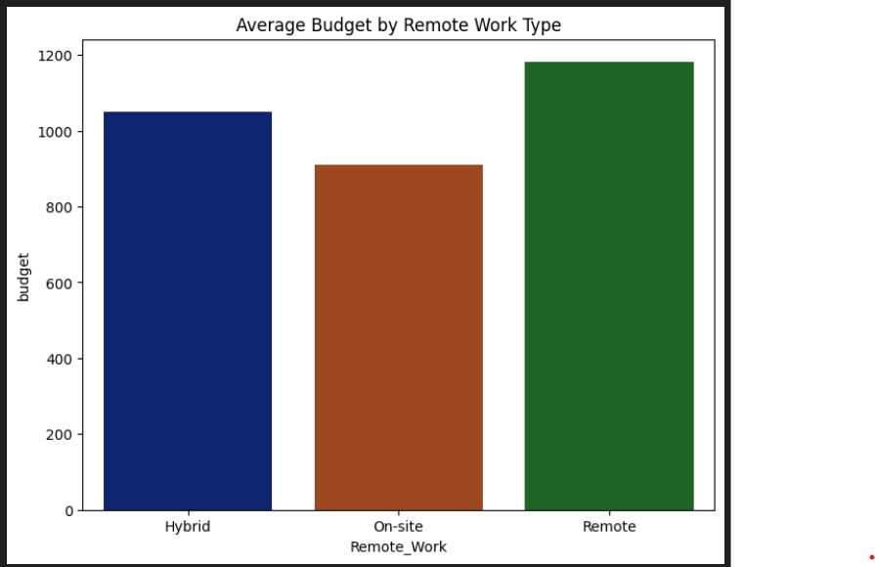
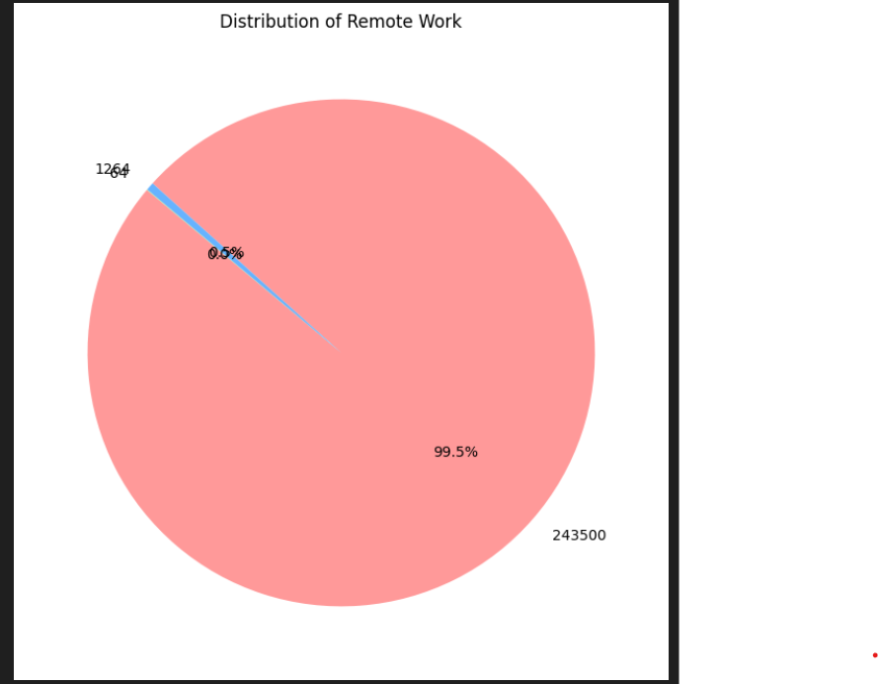
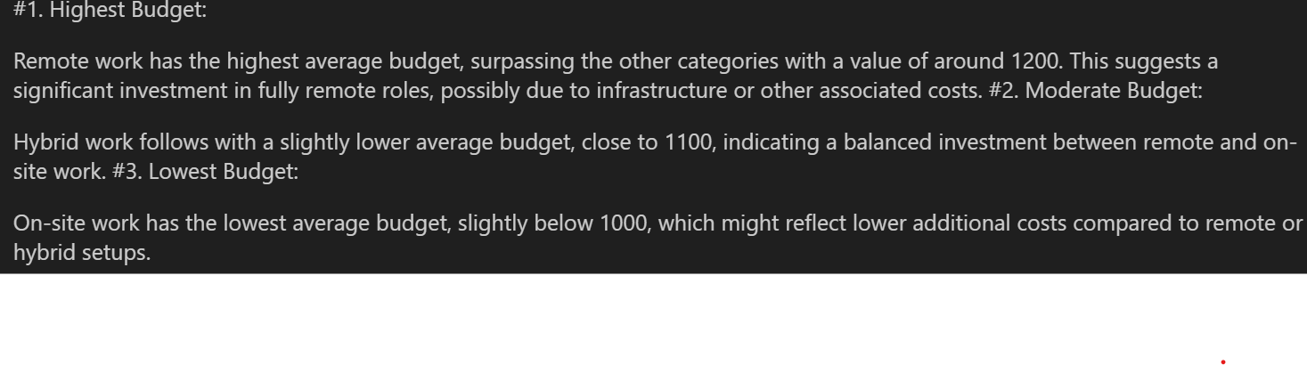

Slide 7
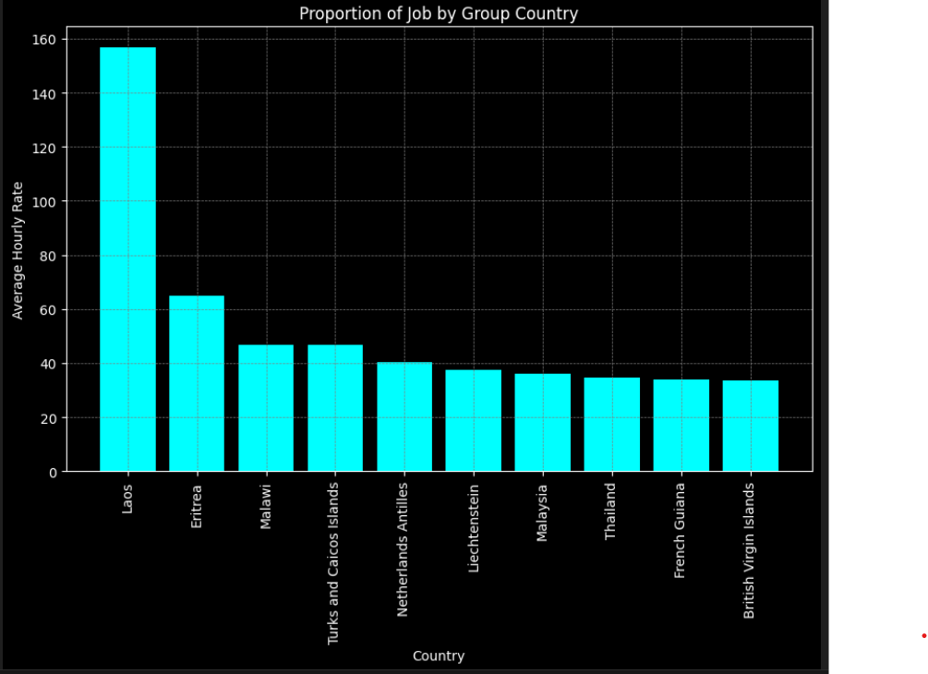
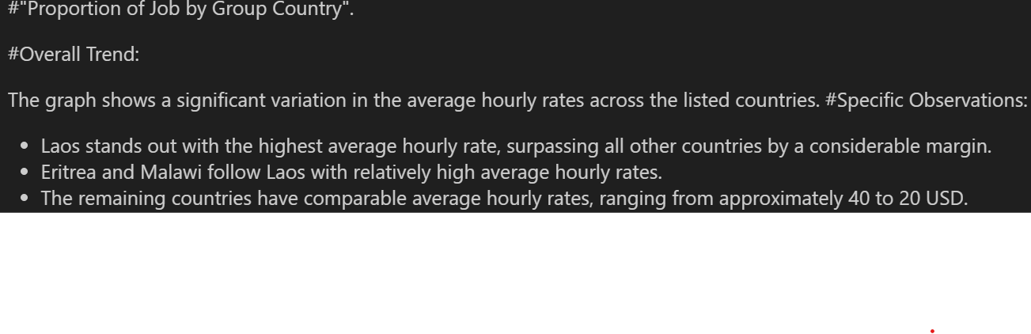

Slide 8
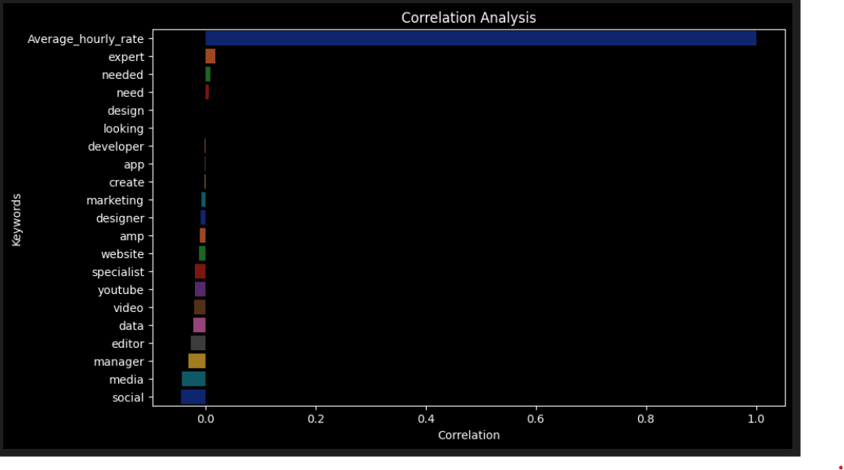
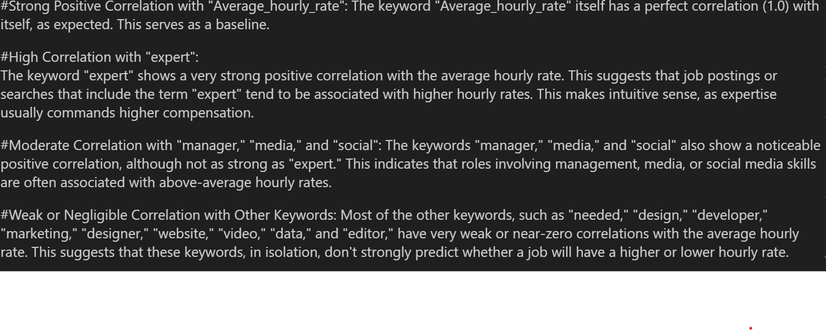

Slide 9
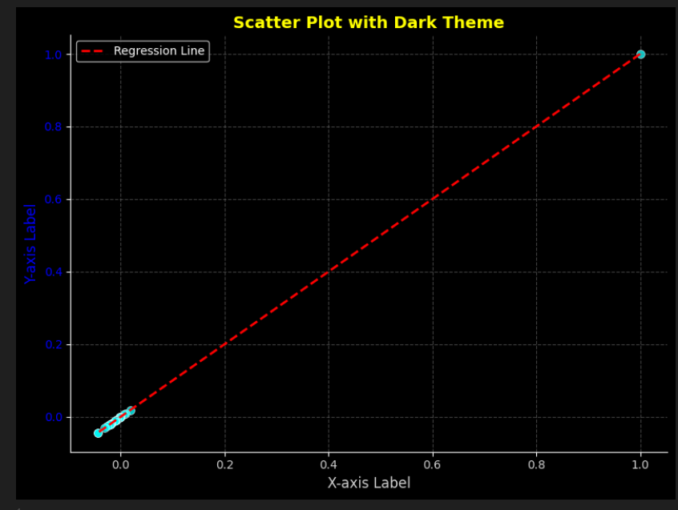
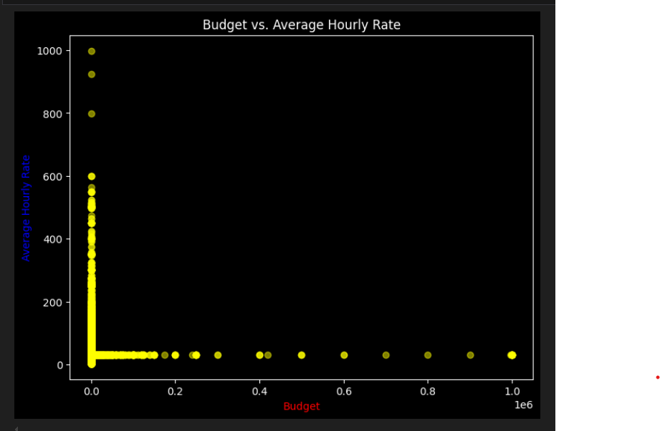
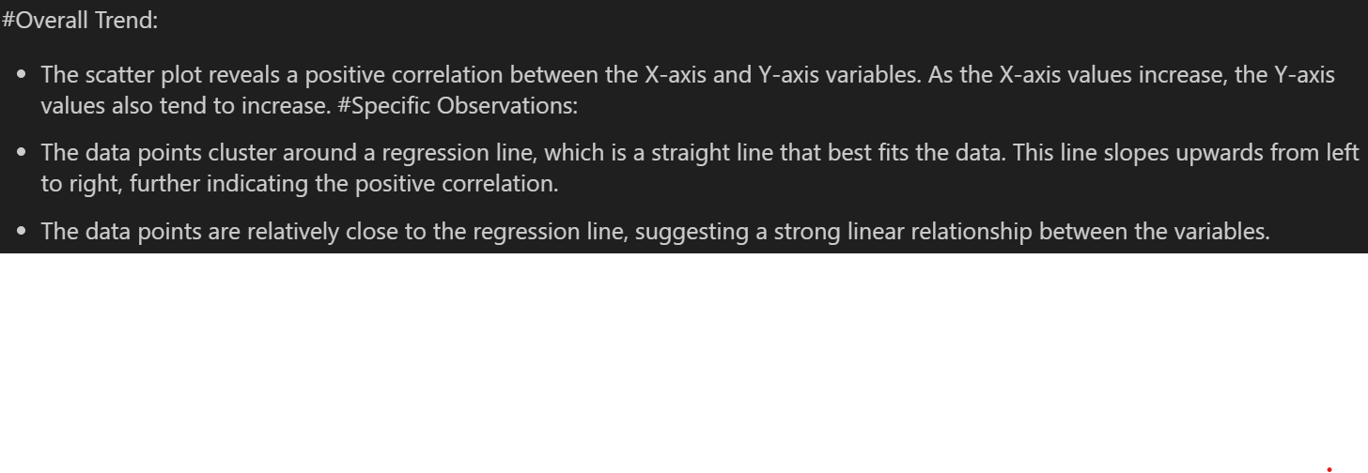

Slide 10
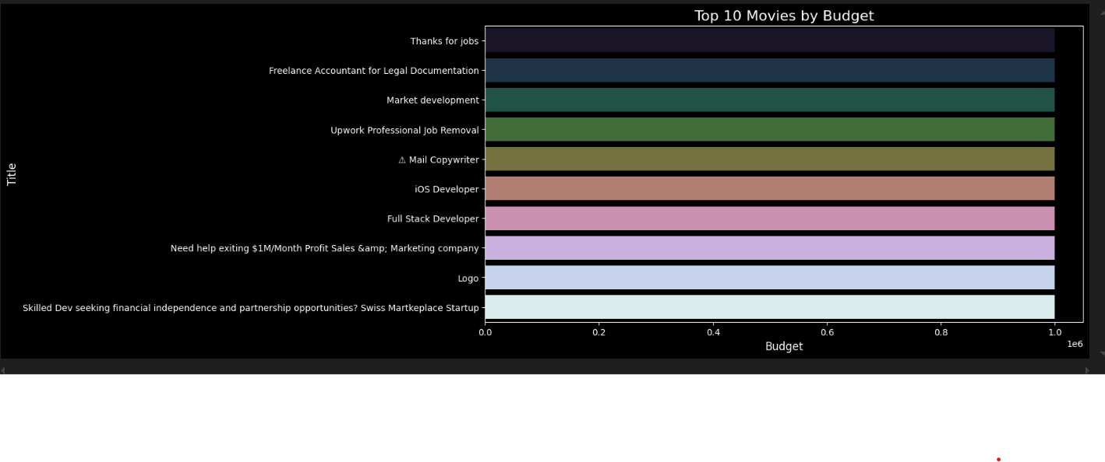
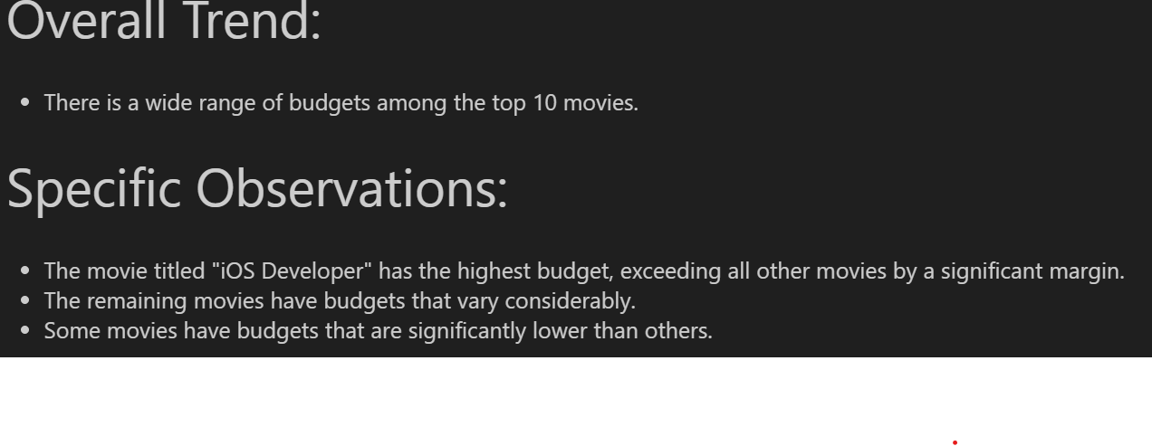

Slide 11
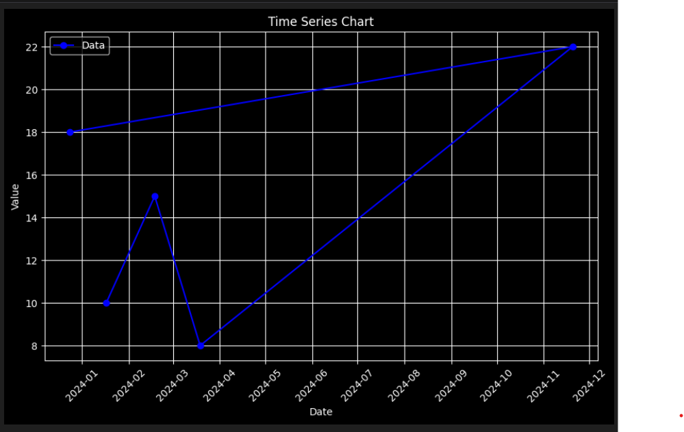
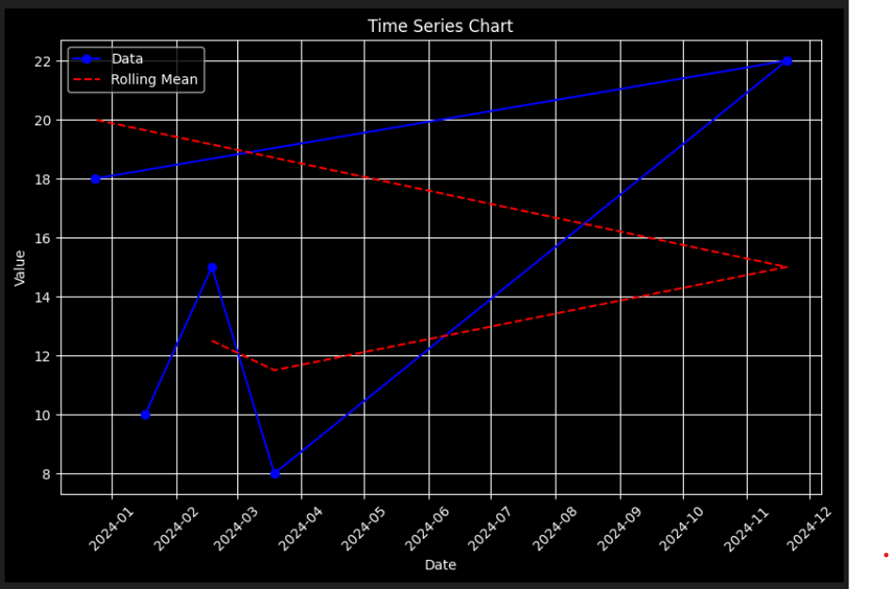
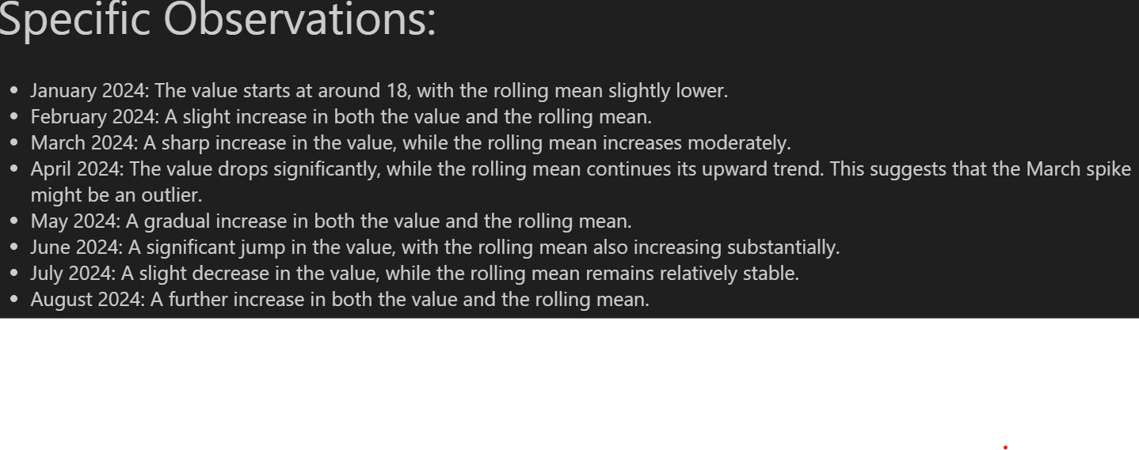

Slide 12
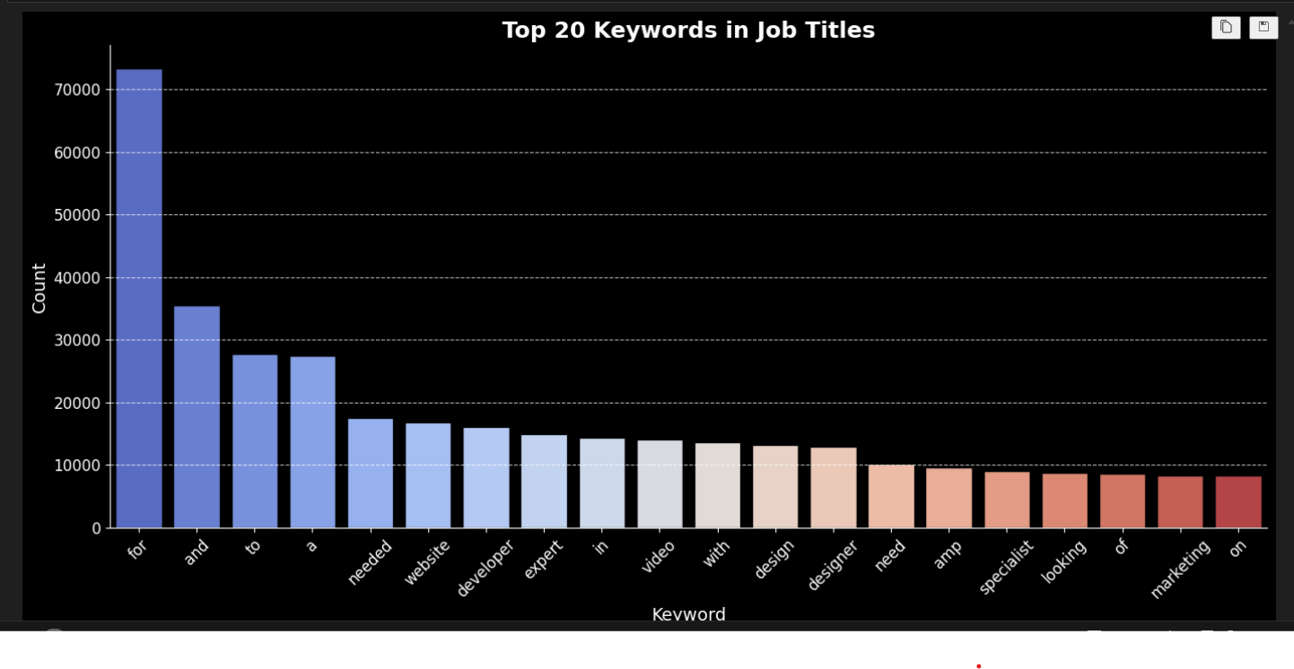
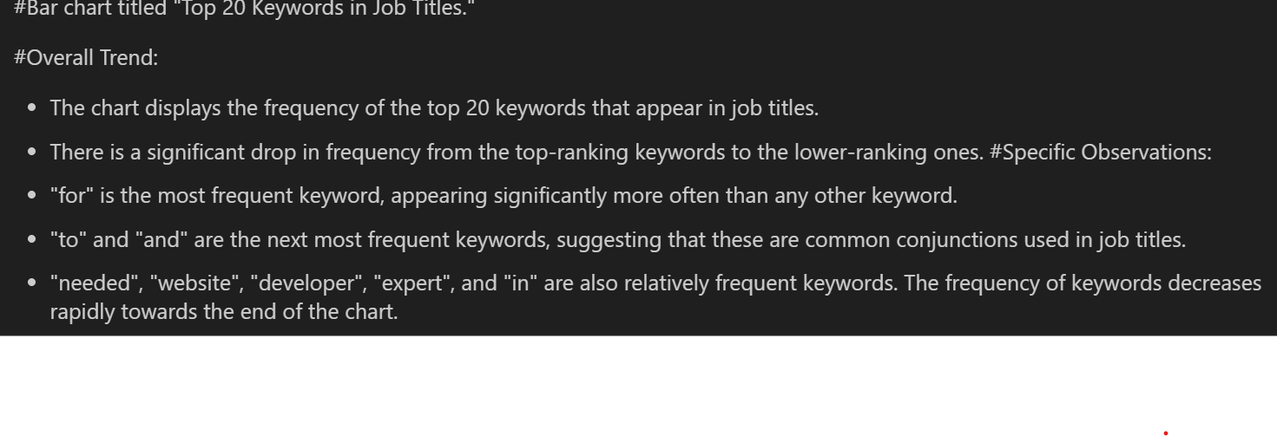

Slide 13
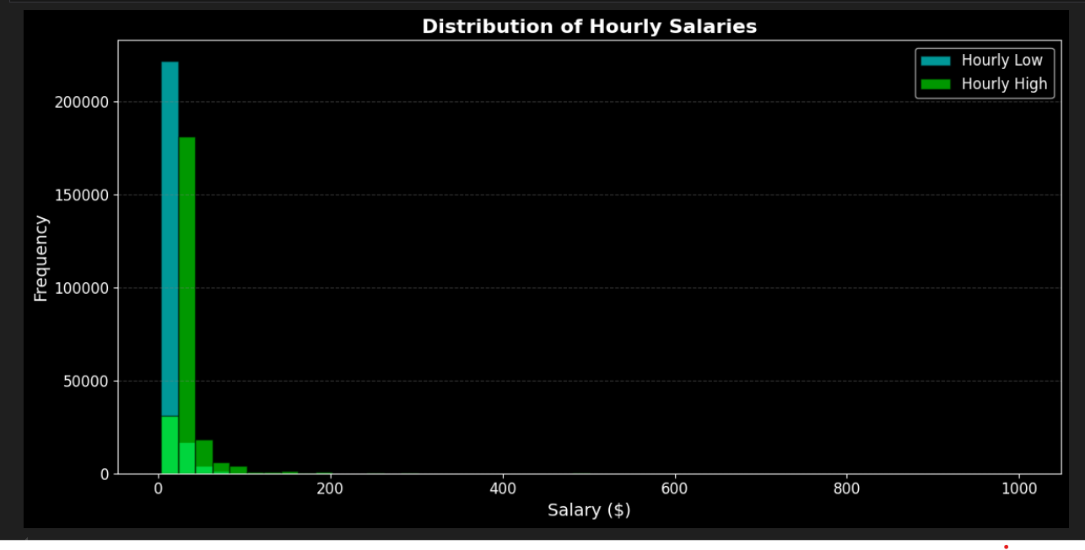
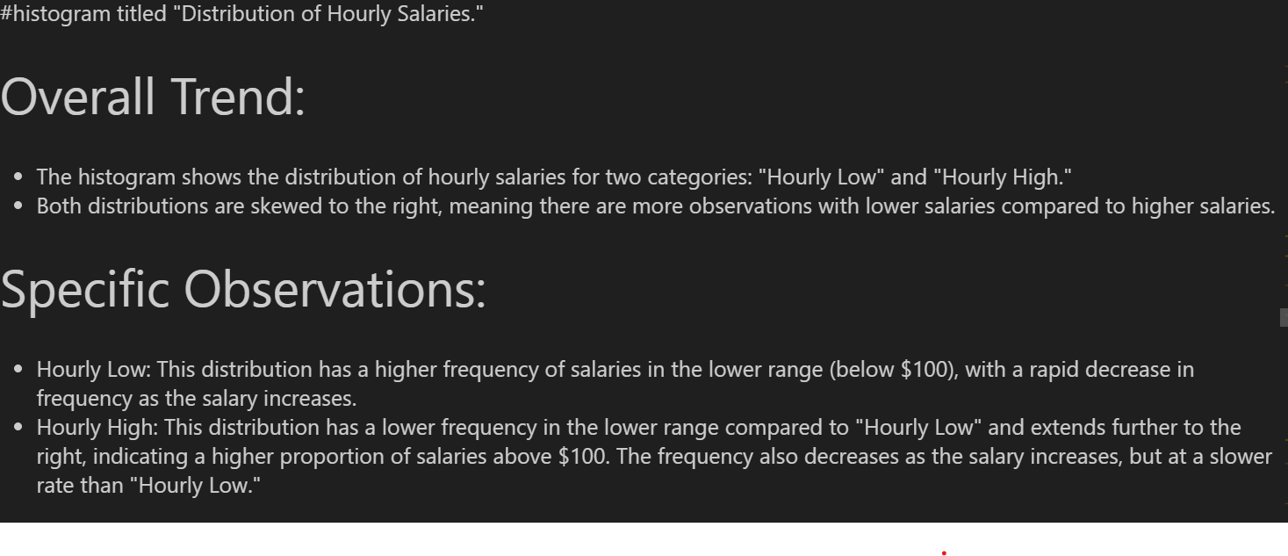

Slide 14
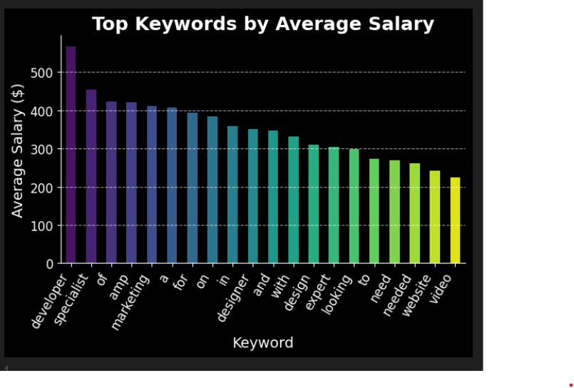
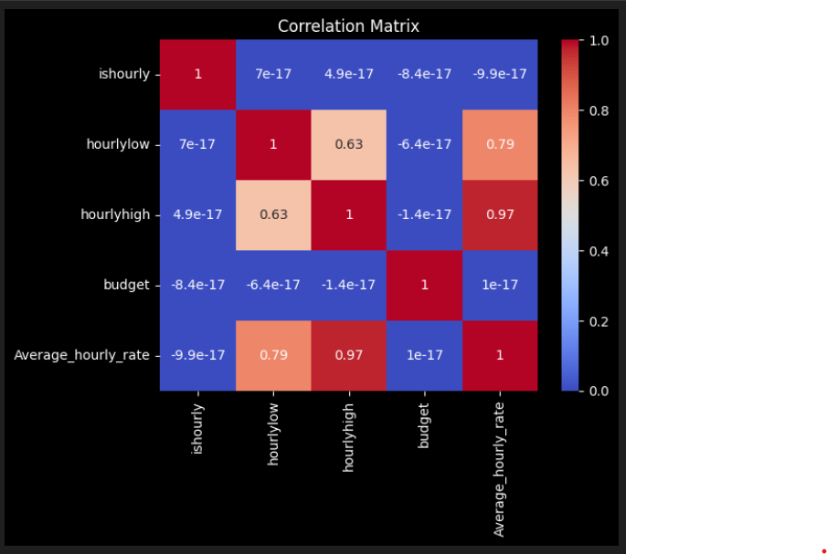
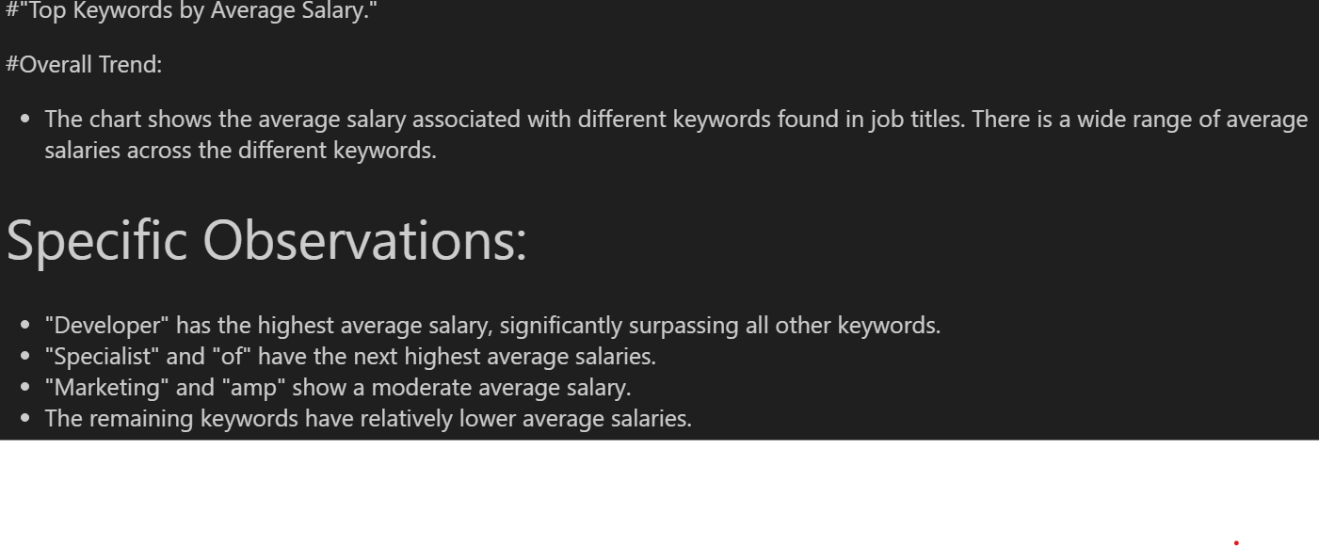

Slide 15
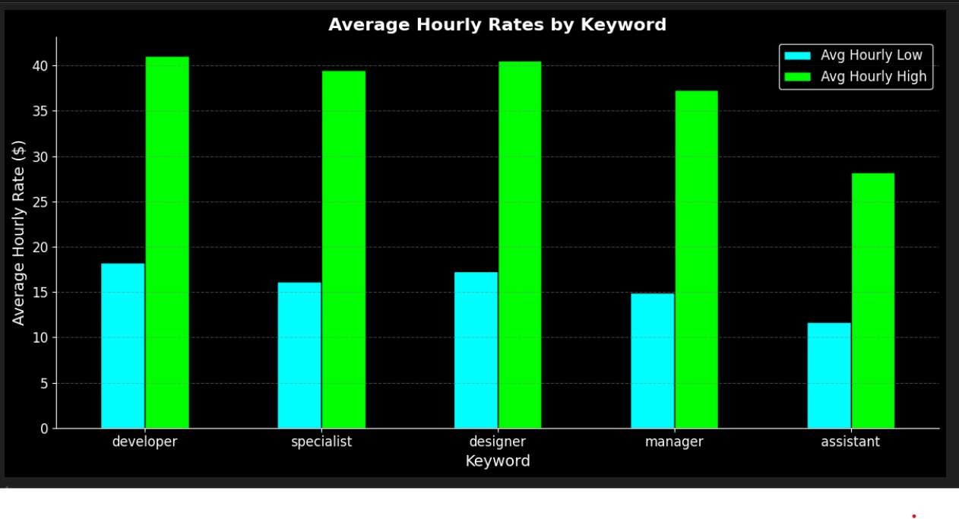
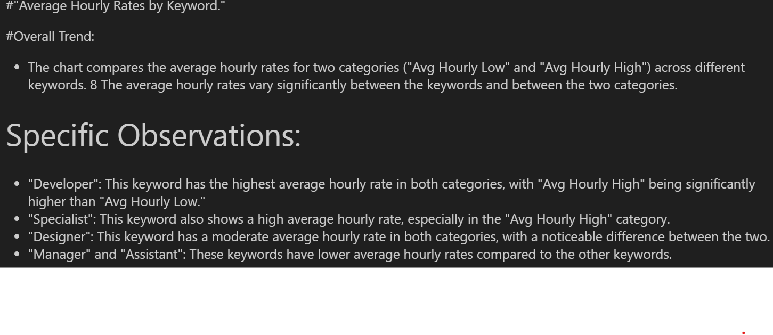

Slide 16
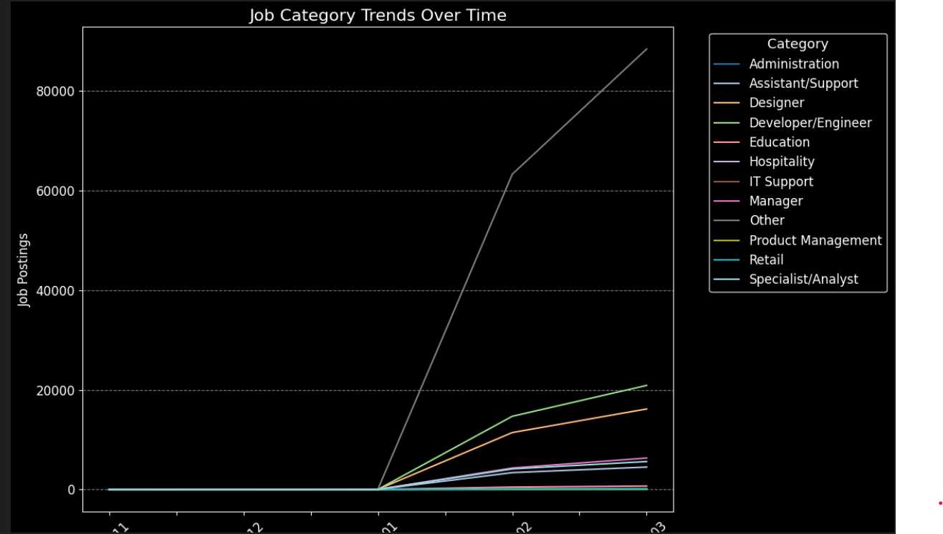
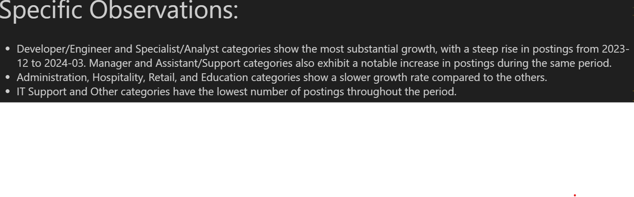

Slide 17
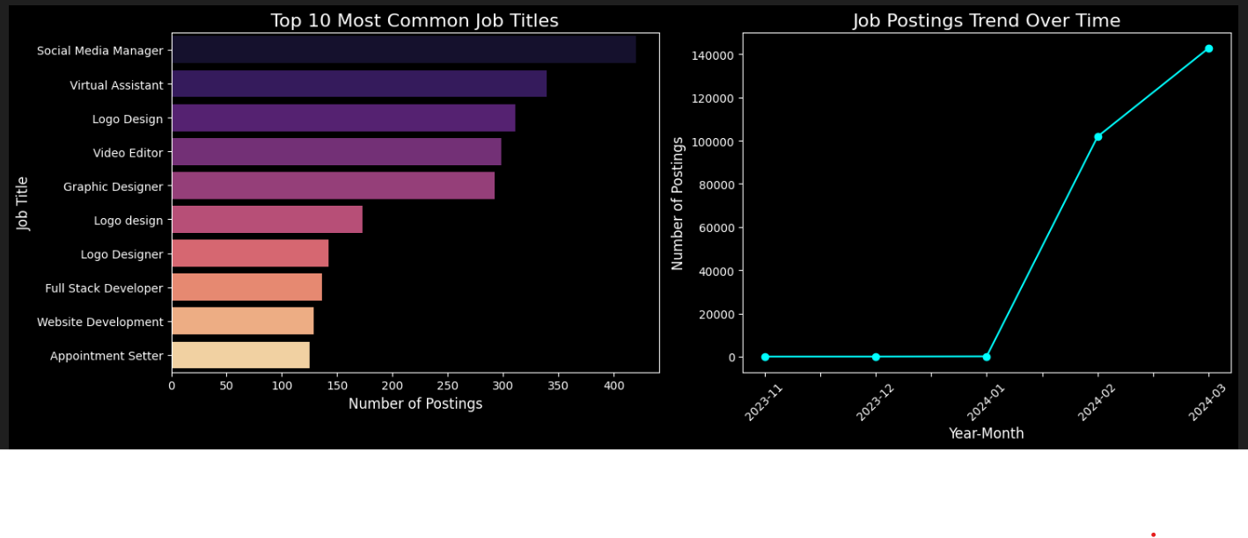
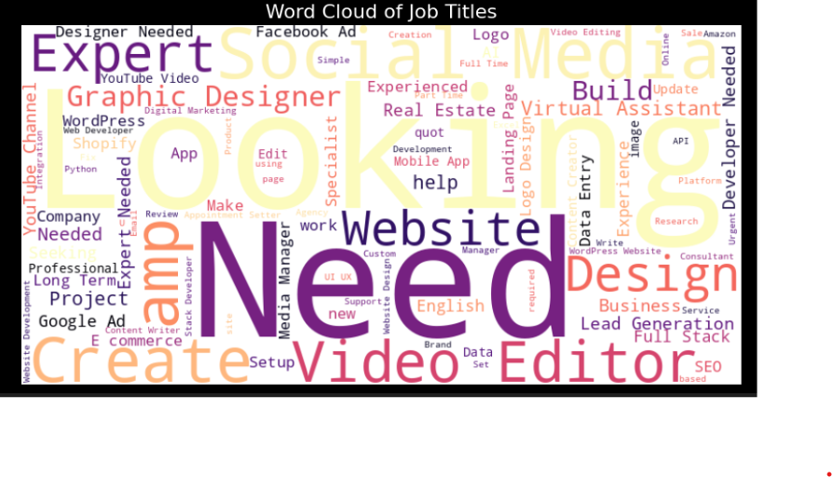
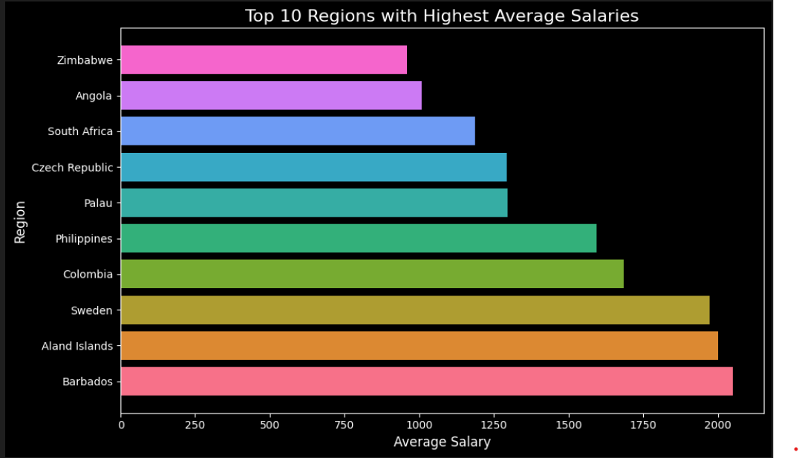

Slide 18
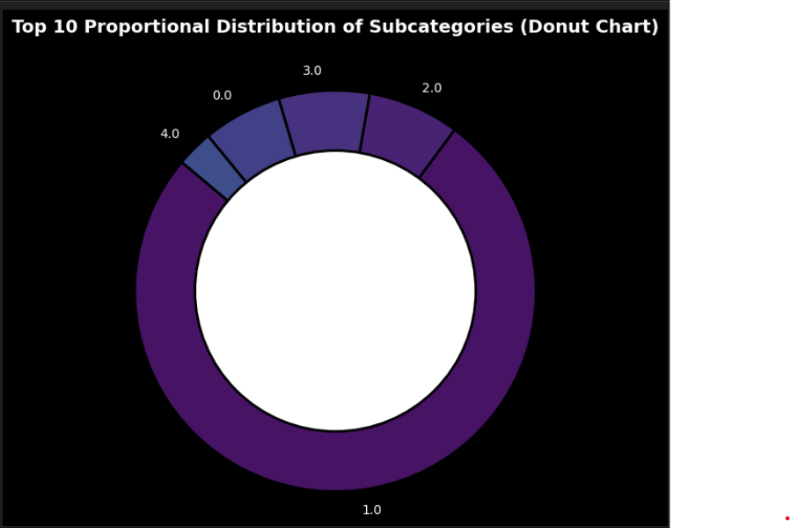
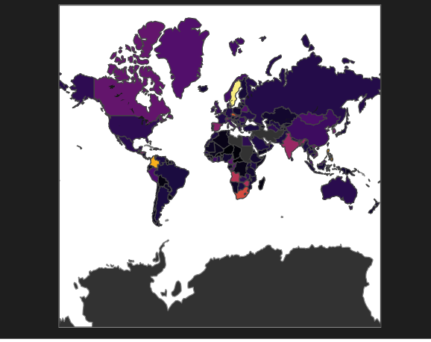
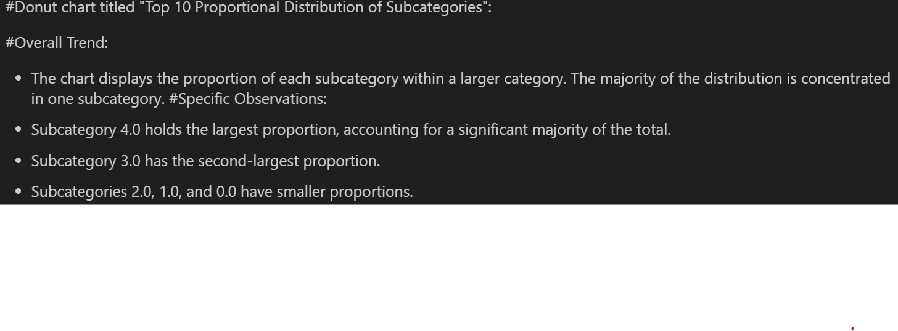

Slide 19
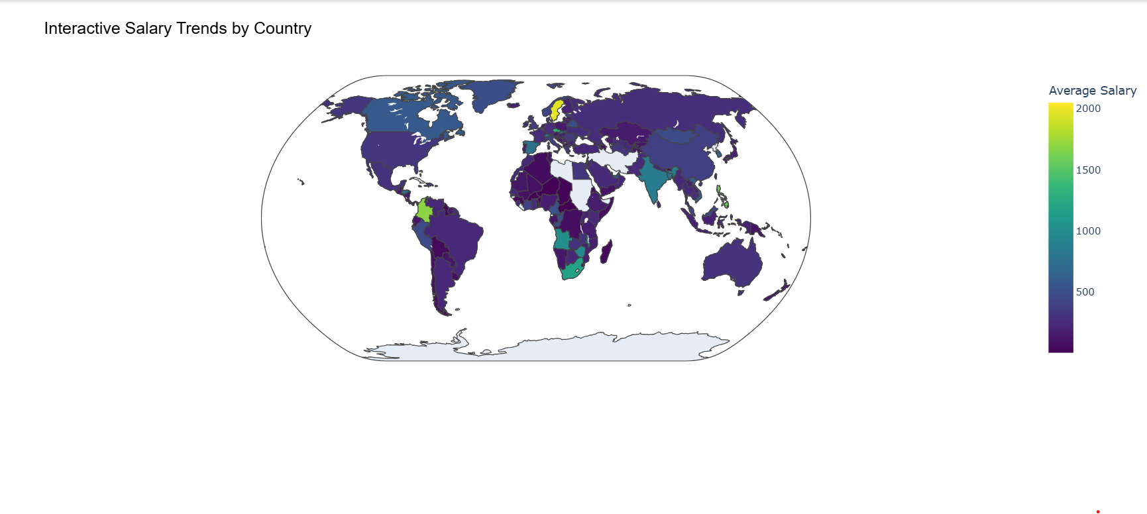

Slide 20
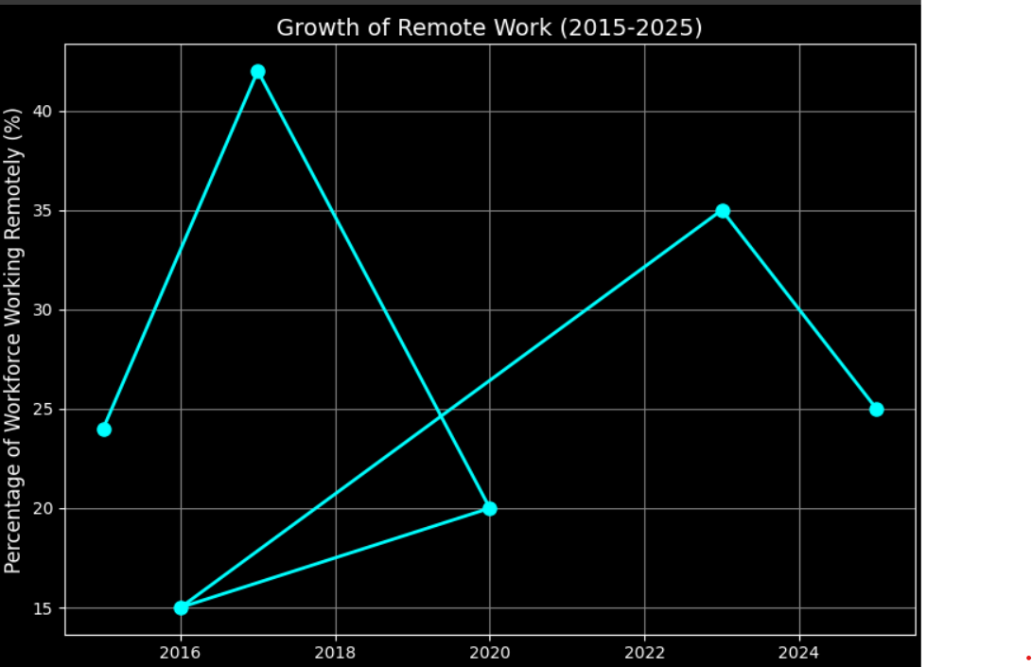
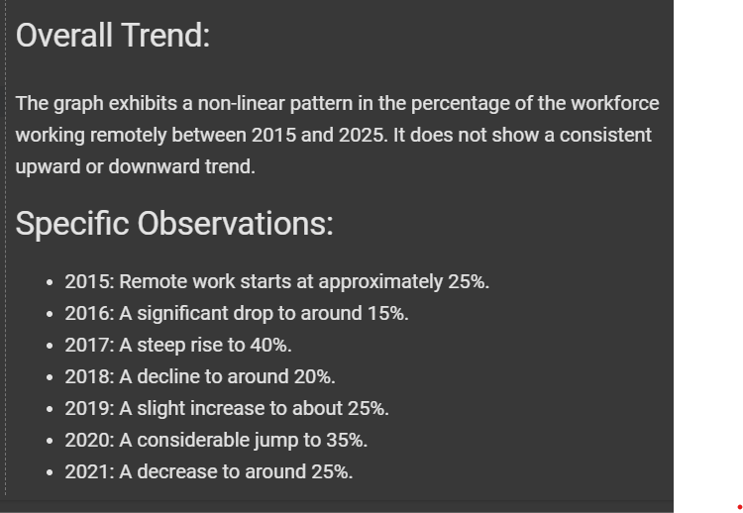

Slide 21
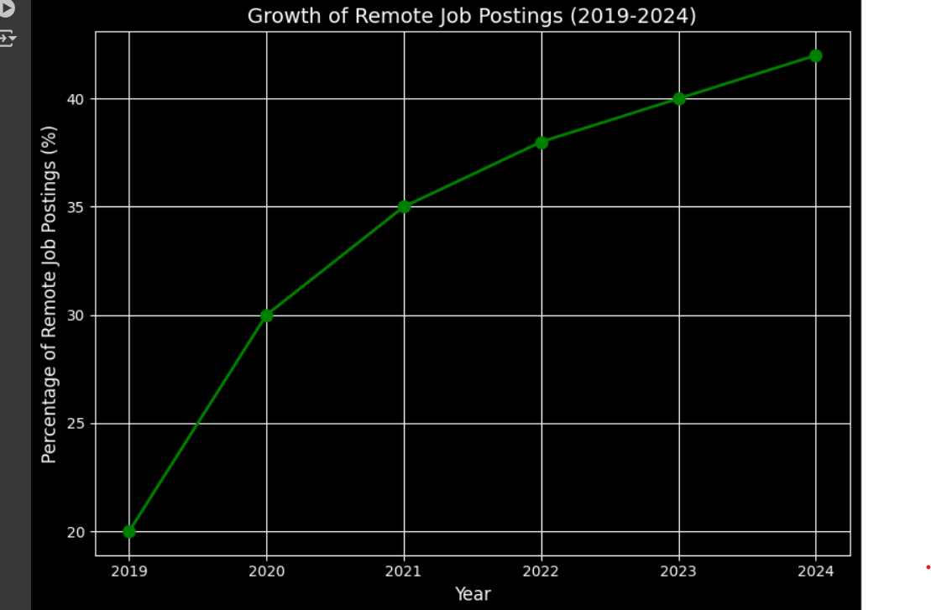
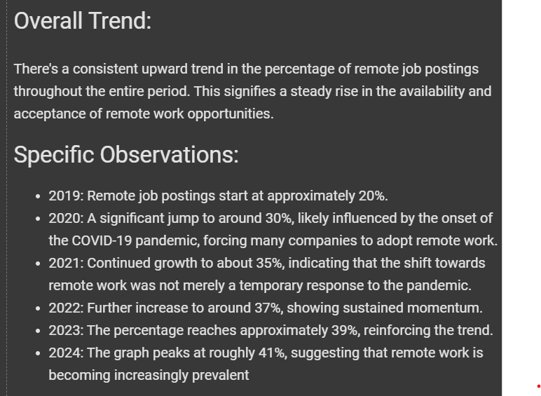

Slide 22
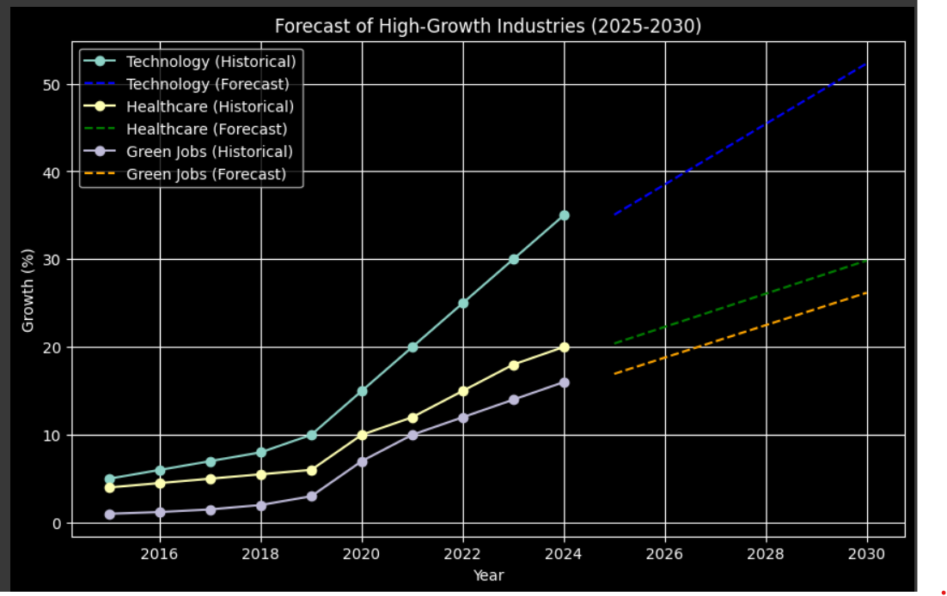
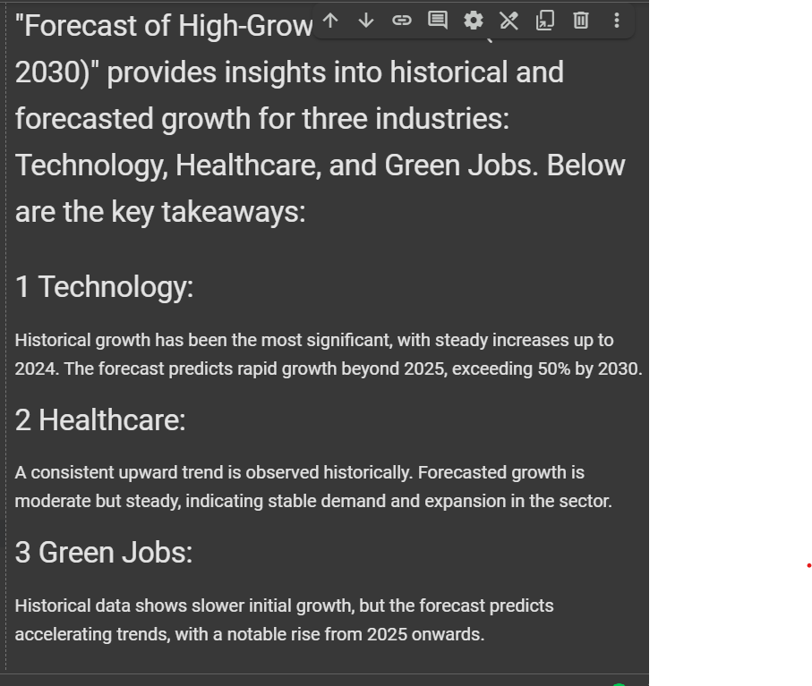

Slide 23


